Slide 1



PATHFIT=3
HISTORY OF
JAZZ
Kurt Daniel Cano
Joshua Gabriel Dantes
Gian Higino Fungo
Christian Serrano
Rodel Sustiguer
Cedric Torres
WEEK-14

Slide 2

PREVIEW
Jazz dance is a vibrant and energetic dance style that emerged alongside the jazz music genre. It incorporates a blend of different dance techniques and influences, creating a unique and captivating performance style.

Slide 3



ORIGINS AND DEVELOPMENT
Jazz dance originated in the early 20th century, inspired by African American rhythms, social dances, and the spirit of jazz music. It gained prominence in the 1920s and 1930s as dancers incorporated elements of tap, ballet, and African dance into their routines.
FITNESS

Slide 4
CHARACTERISTICS
-Jazz dance is characterized by its high energy, syncopated rhythms, and dynamic movements. Dancers often use isolations, sharp movements, and fluid transitions to express emotion and tell a story through their performance.
100%

Slide 5
-Jazz dance has evolved over time and has heavily influenced the development of contemporary dance. Contemporary dance often incorporates jazz techniques along with elements from other dance styles.
EVOLUTION INTO CONTEMPORARY DANCE

Slide 6
EXPRESSION AND CREATIVITY
Jazz dance allows for individual expression and creativity, encouraging dancers to infuse their personality into their movements. It celebrates self-expression and storytelling through dance.

Slide 7
STYLE WITHIN JAZZ DANCE
Jazz dance encompasses a range of styles, including traditional jazz, Broadway jazz, contemporary jazz, and lyrical jazz.
Each style has its own unique movement vocabulary and influences.

Slide 8


EXAMPLE OF JAZZ DANCE

Slide 9
DANCE CHARACTERISTICS
Syncopation and Rhythm: Jazz dance often emphasizes syncopated rhythms and offbeat accents, reflecting the lively and rhythmic nature of jazz music. Dancers frequently use quick, unexpected movements and pauses to create a sense of rhythm and surprise.
Isolations: Jazz dance involves isolating different parts of the body to create contrasting and dynamic movements. Dancers may isolate their hips, shoulders, head, or other body parts, showcasing a clear distinction between different movements.
Contrast and Dynamics: Jazz dance is known for its sharp contrasts between movements, such as sudden shifts from slow to fast, smooth to sharp, or controlled to explosive. These changes in dynamics contribute to the energetic and captivating nature of jazz dance.
Improvisation: Like jazz music, improvisation is a significant aspect of jazz dance. Dancers often have the freedom to interpret the music and express themselves through spontaneous movements, showcasing their individuality and creativity.

Slide 10
TECHNIQUE AND MOVES
Jazz dance incorporates a variety of steps and movements, such as kicks, turns, jumps, leaps, and isolations of the body. Flexibility, strength, and control are important aspects of jazz dance technique.

Slide 11
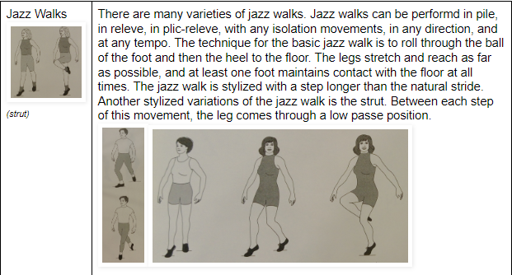
MOVEMENT SKILLS

Slide 12
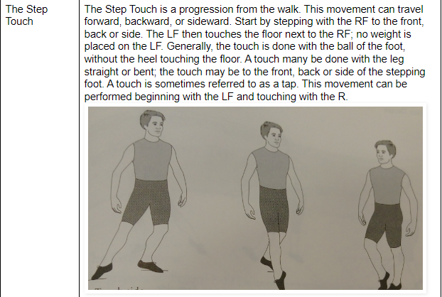
MOVEMENT SKILLS

Slide 13
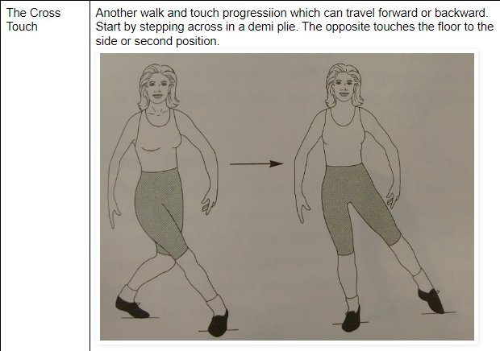
MOVEMENT SKILLS

Slide 14
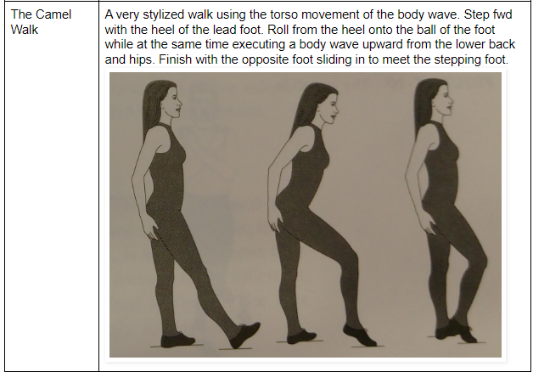
MOVEMENT SKILLS

Slide 15
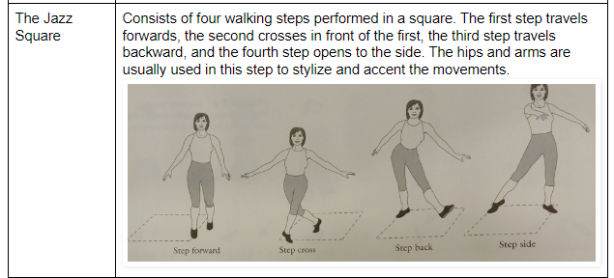
MOVEMENT SKILLS

Slide 16
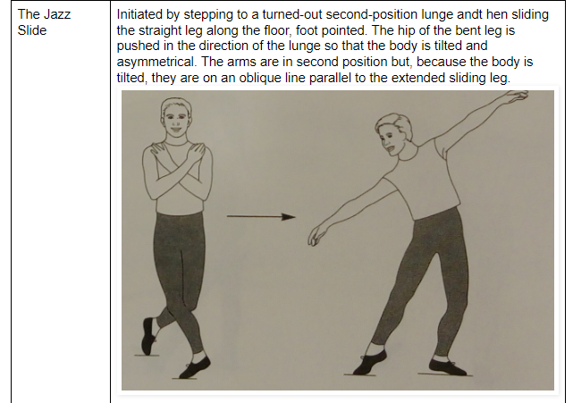
MOVEMENT SKILLS

Slide 17
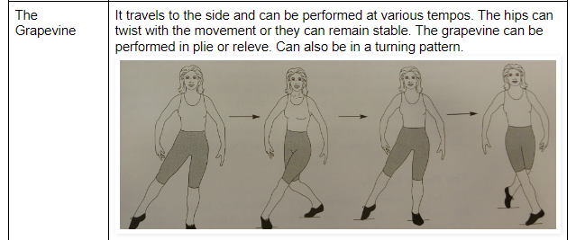
MOVEMENT SKILLS

Slide 18
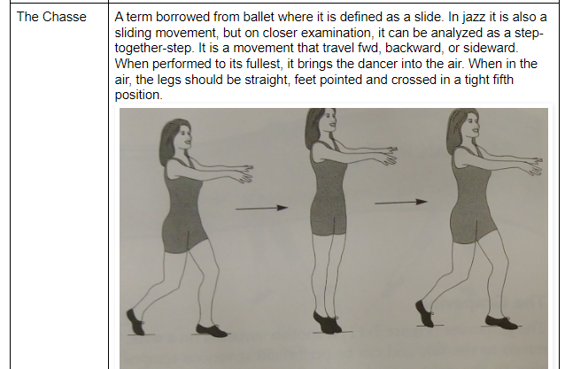
MOVEMENT SKILLS

Slide 19
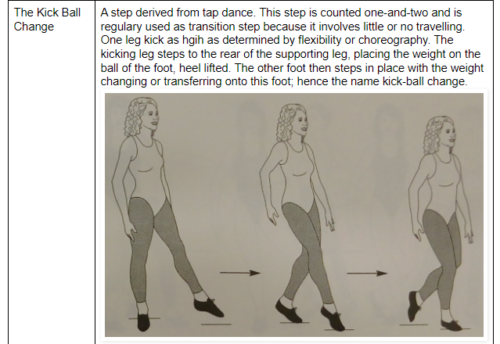
MOVEMENT SKILLS

Slide 20
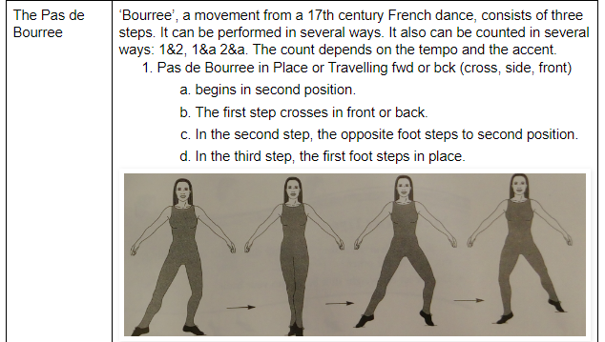
MOVEMENT SKILLS

Slide 21
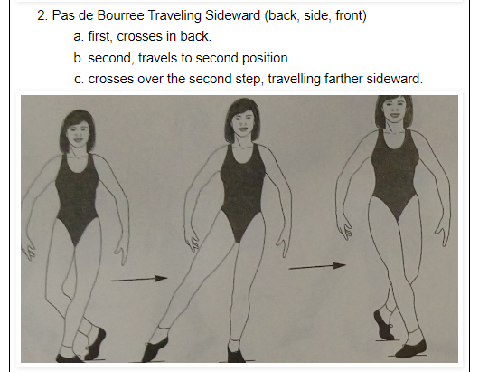
MOVEMENT SKILLS

Slide 22
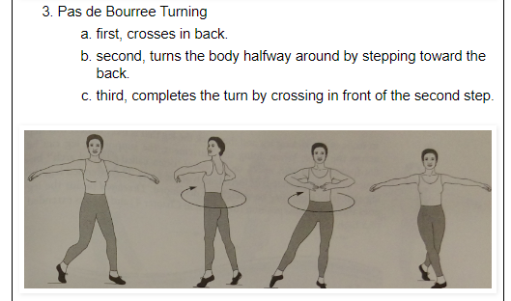
MOVEMENT SKILLS

Slide 23
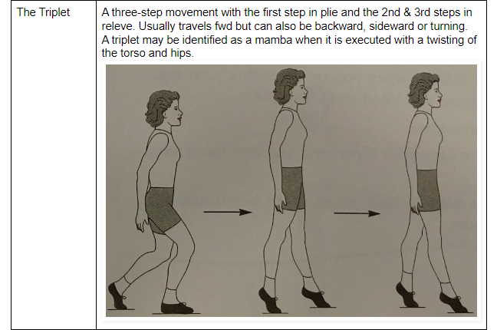
MOVEMENT SKILLS

Slide 24
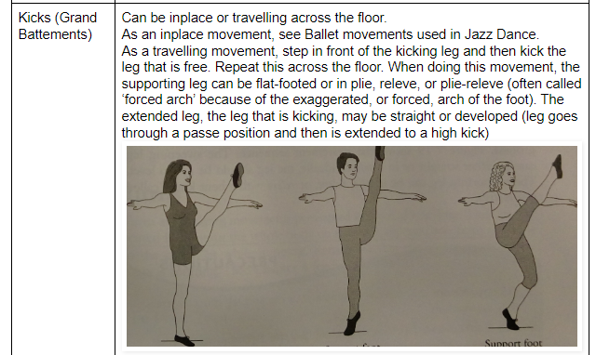
MOVEMENT SKILLS

Slide 25
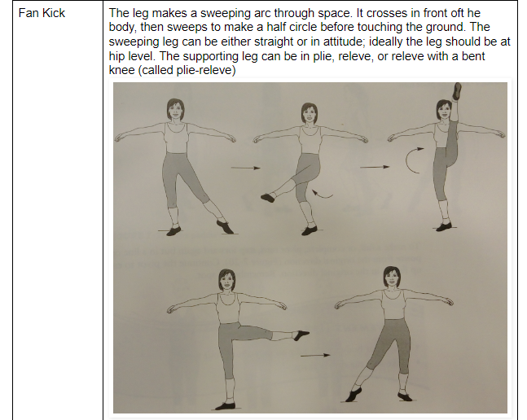
MOVEMENT SKILLS

Slide 26
FITNESS BENEFITS OF JAZZ
Cardiovascular Endurance: Jazz dance involves continuous movement, which can elevate your heart rate and improve cardiovascular endurance. It can contribute to better heart health and lung capacity.
Muscular Strength and Tone: Jazz dance movements often require the use of various muscle groups, such as the legs, core, and upper body. This can help increase muscular strength and tone, leading to improved overall muscle definition.

Slide 27
FITNESS BENEFITS OF JAZZ
Flexibility: Many jazz dance movements involve stretching and elongating muscles, promoting flexibility. It will help improve your range of motion and reduce the risk of injuries.
Coordination and Balance: Jazz dance incorporates intricate footwork, quick transitions, and complex movements that challenge your coordination and balance. Practicing these movements can enhance your overall body control and stability.

Slide 28
FITNESS BENEFITS OF JAZZ
Core Engagement: Jazz dance often emphasizes strong core engagement to execute movements with control and precision. This can lead to improved core strength and stability.
Weight Management: The energetic and dynamic nature of jazz dance can help you burn calories and contribute to weight management.

Slide 29
DIETARY GOALS
Just as jazz dance requires energy and dynamism, set a dietary goal to fuel your body with nutritious foods that provide sustained energy. Prioritize complex carbohydrates, lean proteins, and healthy fats to keep you energized during dance sessions.
Aim to maintain hydration harmony by drinking enough water throughout the day. Proper hydration supports muscle function, endurance, and overall performance.
Strive for balanced nutritional harmony by incorporating a mix of macronutrients (carbohydrates, proteins, fats) and micronutrients (vitamins, minerals) into your meals.

Slide 30
DIETARY GOALS
After a jazz dance performance, recovery is essential. Apply this concept to your diet by including post-exercise meals that contain protein for muscle repair and carbohydrates for replenishing glycogen stores.

Slide 31

In essence, jazz dance is a lively and diverse dance style that captures the essence of jazz music while incorporating a wide range of movements, techniques, and emotions.
PATHFIT-3
THANK'S FOR LISTENING

